Slide 1
DEEP LEARNING USING PYTHON LUNG CANCER DETECTION USING CNN
NIELIT SUMMER INTERN 2021
PRESENTED BY:-
BHAVNA SINGH
RITIK PAL
SANDEEP CHANDRA
SIDDHANT KUMAR

Slide 2
WHY CNN?

Slide 3
CODE EDITORS AND LANGUAGES USED
Jupyter Notebook (Anaconda 3)
Python 3.9

Slide 4
MODULES/LIBRARIES USED
TENSORFLOW
NUMPY
DICOM
OS
PANDA
MATPLOTLIB
CV2
MATH

Slide 5
Features:
Image Detection of Possible Tumor
Confirmation of Tumor

Slide 6
Description:
Lung cancer detection at early stage has become very important and also very easy with image processing and deep learning techniques. In this study lung patient Computer Tomography (CT) scan images are used to detect and classify the lung nodules and to detect the malignancy level of that nodules.
The lung nodules are classified and malignancy level is detected using CNN architecture.

Slide 7
SCREENSHOT OF RESULTS:

Slide 8
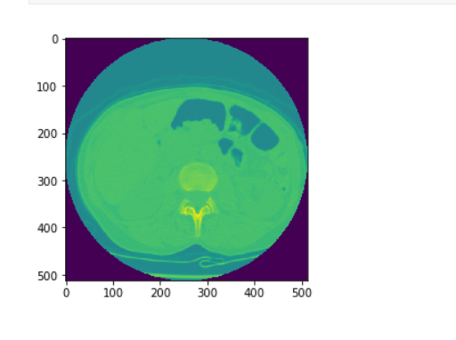
WHAT A SCAN IMAGE LOOK LIKE:

Slide 9
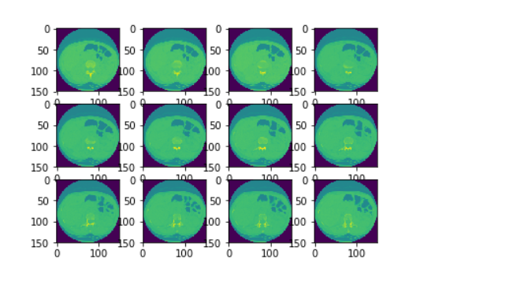
RESIZED CT SCANS:

Slide 10
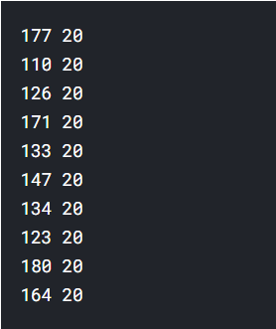
VARIABLES WE TWEAK:

Slide 11
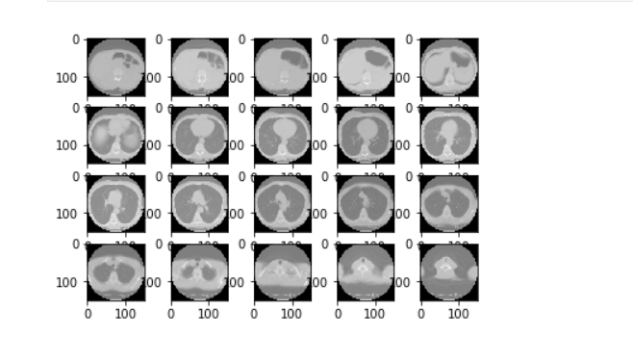
PREPROCESSING:

Slide 12
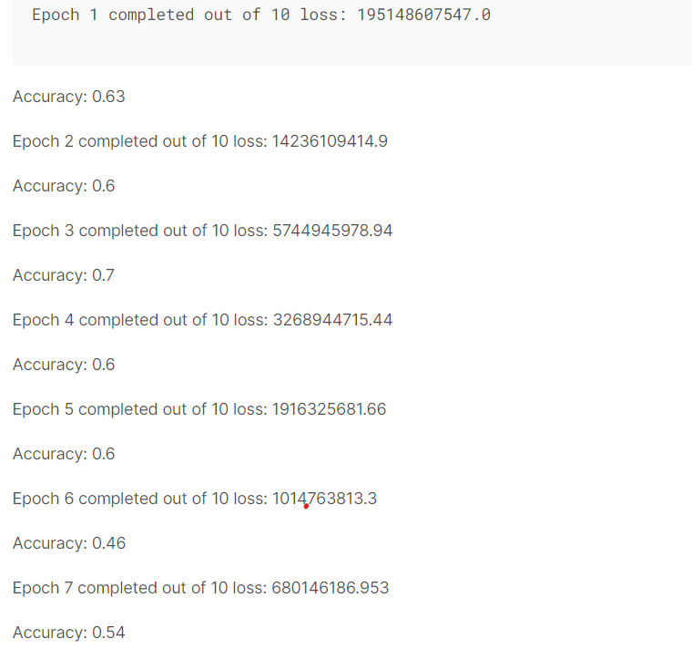
EPOCH AND ACCURACY:

Slide 13
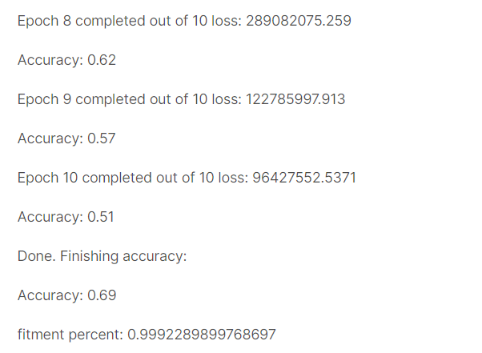
EPOCH AND ACCURACY:

Slide 14
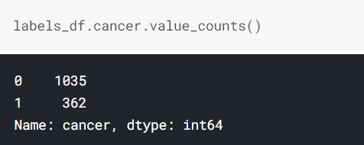
REMARKS:
Our dataset has 1035 non-cancer examples and 362 cancerous examples. Thus, an algorithm that always predicted no-cancer with our model would be ~ 74% accurate (1035/1397)

Slide 15
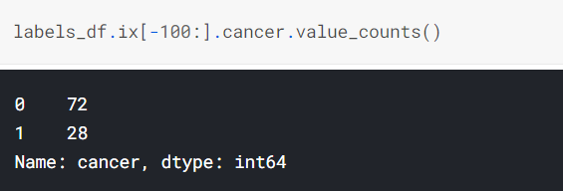
REMARKS:

Slide 16
THANKYOU!!!

